Slide 1
Proton Patient Log File Analysis for Machine Performance Evaluation
Madison Grayson¹, Dr. Ricardo Alarcon¹, Dr. Daniel Robertson²
1. Arizona State University, Department of Physics, 2. Mayo Clinic Arizona, Radiation Oncology

Slide 2
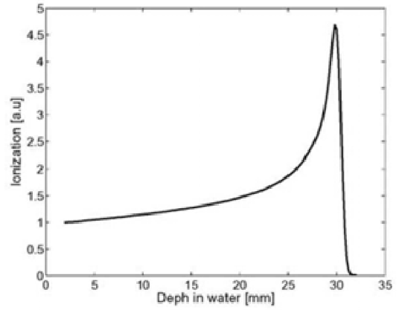
Introduction
Proton therapy is one of the most advanced types of radiation therapy
As the protons slow down after entering the body, most of their energy is deposited at a specific depth
Objective: Analyze treatment log files to identify machine performance trends over time
Identify machine issues before they cause downtime or degrade treatment quality
Figure 1. Proton Bragg peak in water
Source: Cirrone, et al. [1]

Slide 3
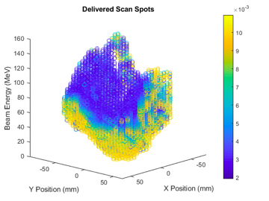
Log Files
Log files are produced from each patient treatment:
Gantry
Delivered spot position
Gantry angle
Monitor units (MUs)
Provides a treatment record
Used for patient-specific QA

Slide 4
Methods
All patient treatment logs are stored in DICOM format
Software was developed to extract the spot position, MUs, and gantry angle from all log files
Mean spot position error and MU error were calculated for each delivered field
A total of 22 months of treatments on 4 gantries were analyzed, including 43,807 total fields

Slide 5
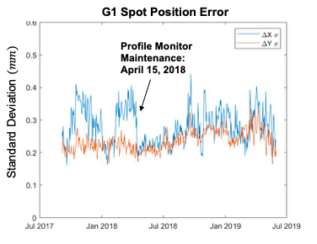
Results - Machine Maintenance

Slide 6
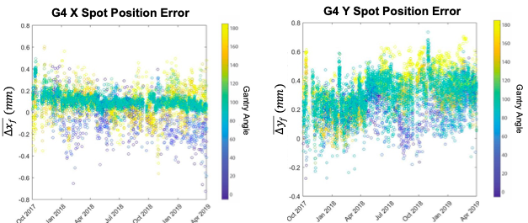
Results - Spot Position for G4

Slide 7
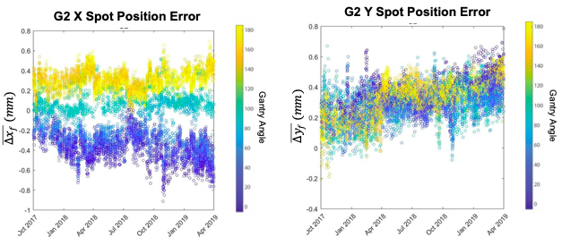
Results - Spot Position for G2

Slide 8
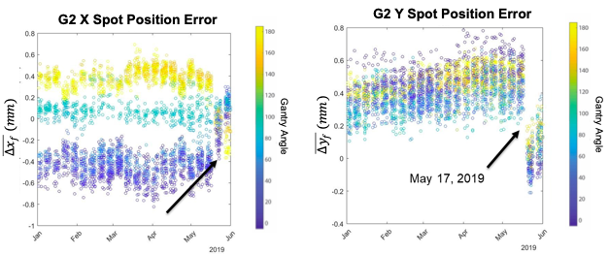
Results - G2 After Maintenance

Slide 9
Conclusions
Daily/monthly QA measurements might catch these deviations
Field-by-field data provides more continuous, granular description of machine performance
Also more representative of machine usage than QA test patterns

Slide 10
Future Work
Development of log file analysis metrics to preemptively diagnose performance issues
Continuously monitor system performance
Expand to use more detailed log files
MU1 vs MU2
Spot size
Delayed charge
Magnet currents

Slide 11
Acknowledgements
References
Niels Arnesen, Hitachi America Limited
Larry Patnode, Hitachi America Limited
Keith Furutani, PhD, Mayo Clinic
[1] Cirrone, et al.(2009). Dosimetric and clinical experience in eye proton treatment at INFN-LNS. 1120. 10.1063/1.3141651

Slide 12
Thank you!
Any questions?

